Slide 1
MIS 321
Singleton Design Pattern - Lab

Slide 2
The Problem
Sometimes we only need (or want) one instance of a class.
Example – Keyboard, drivers, in some cases database connections, etc.
We want to make it impossible to get a 2nd one

Slide 3
The Problem
Can we just create, destroy, then recreate
Creating some objects can take a lot of time
Extra object can take up memory if they are not “cleaned up” properly
If you end up with multiple objects that should be unique, you could have bugs

Slide 4
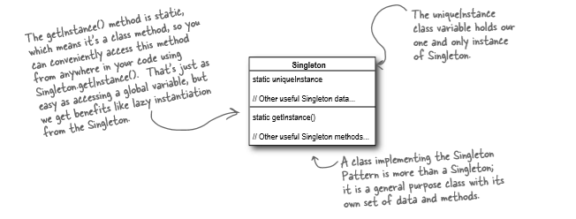
Singleton Pattern
Ensures a class has no more than one instance, and provides a global point of access to it.

Slide 5
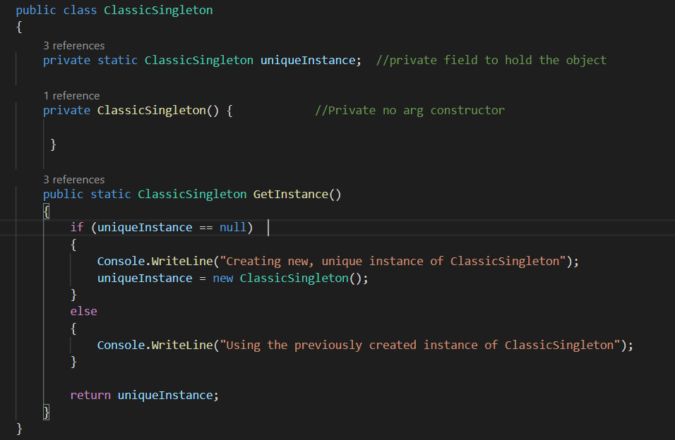
Classic Singleton

Slide 6
Multithreading
Feature provided by the operating system that enables your application to have more than one execution path at the same time.
Example
MS word can take input from the user and display it on the screen in one thread while it continues to check spelling in another thread.
If multiple threads are running, how do you know one thing will happen before the other? How do we know our object wasn’t created in another thread?

Slide 7
Lock Keyword
Lock keyword ensures that one thread is executing a piece of code at any one time. The lock keyword ensures that one thread does not enter a section of code while another thread is in that same section.
From MS docs – acquires a mutual-exclusion lock for a given object, executes a statement block, then releases the lock.

Slide 8
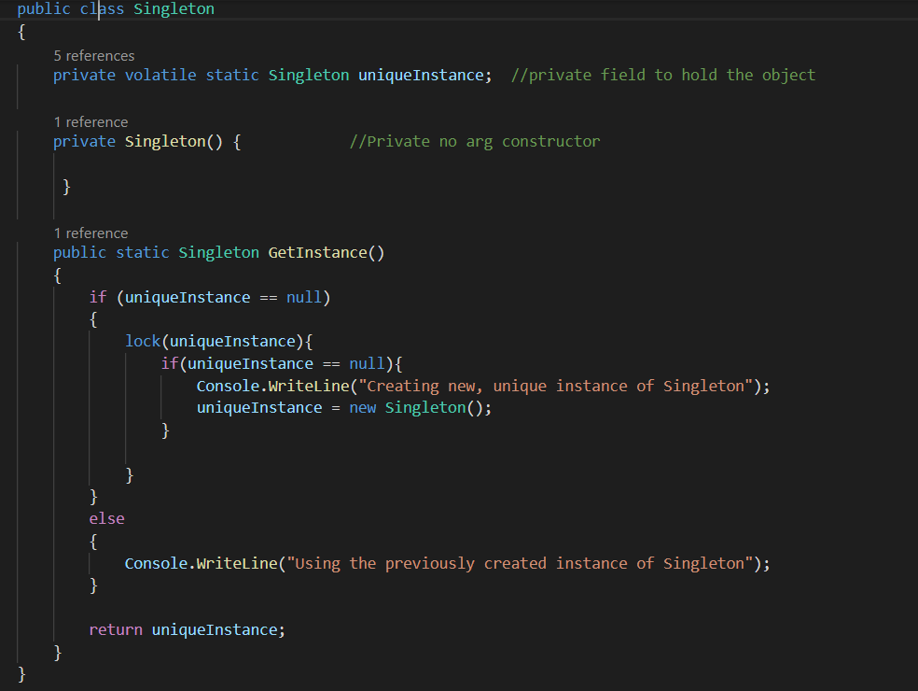
Reworked Code

